Slide 1

Iot based Smart Farming System using ML - Vishnu Vardhan Reddy Yeruva

Slide 2

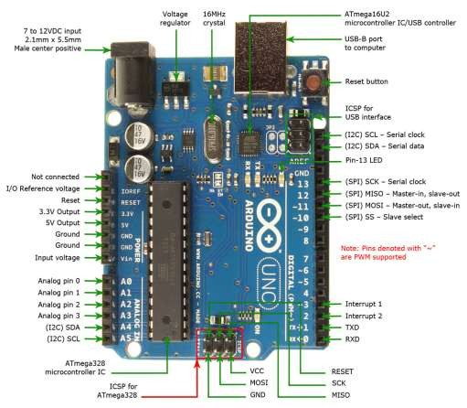
Introduction
Agriculture has recently been identified as one of the main strengths of the global and national economies.
Agriculture is undergoing a significant revolution in the collection and use of data to inform effective agricultural choices.
In general, the agro-industrial and environmental sectors use IoTs and data analysis in both diagnostics and control of smart farming systems

Slide 3
Purpose of smart farms
Automation
Efficient
Climate Independency
Reducing wastage of resources
Maximizing Crop yield
Environmental Friendly
Absorbing CO2

Slide 4
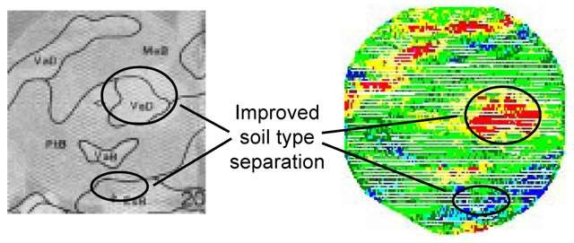
Sensors
Electro Magnetic
Optical
Mechanical
Electro chemical
Airflow
Acoustic

Slide 5
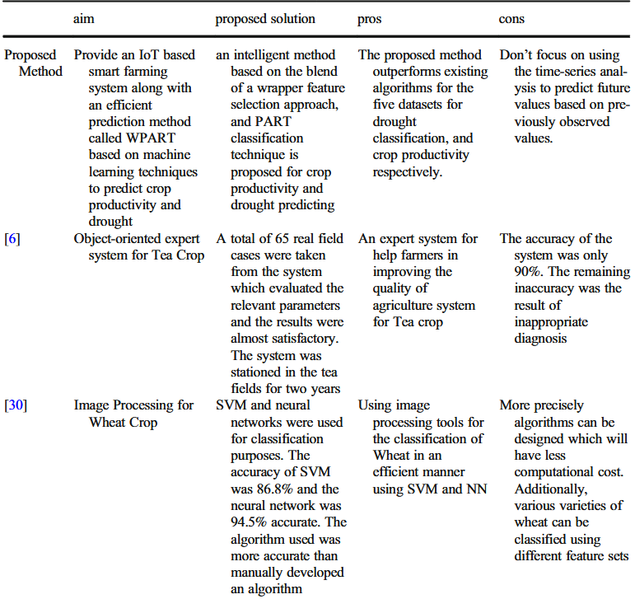
Previous work
This study proposes an efficient prediction method consists of three phases precisely:
(1) Data Preparation Phase (DPP) (2) Feature Selection Phase (FSP) (3) Prediction Phase (PP)

Slide 6
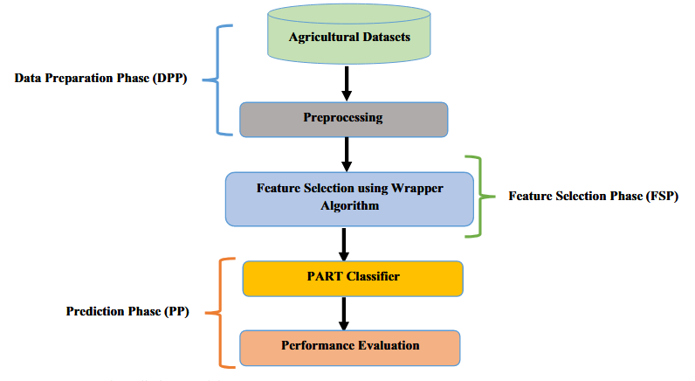
Proposed Solution
The Wrapper algorithm is fundamentally tackling the challenge of maximizing classifier performance. While the PART is an enhanced version of the C4.5 and RIPPER procedures, it is a partial decision tree approach.

Slide 7
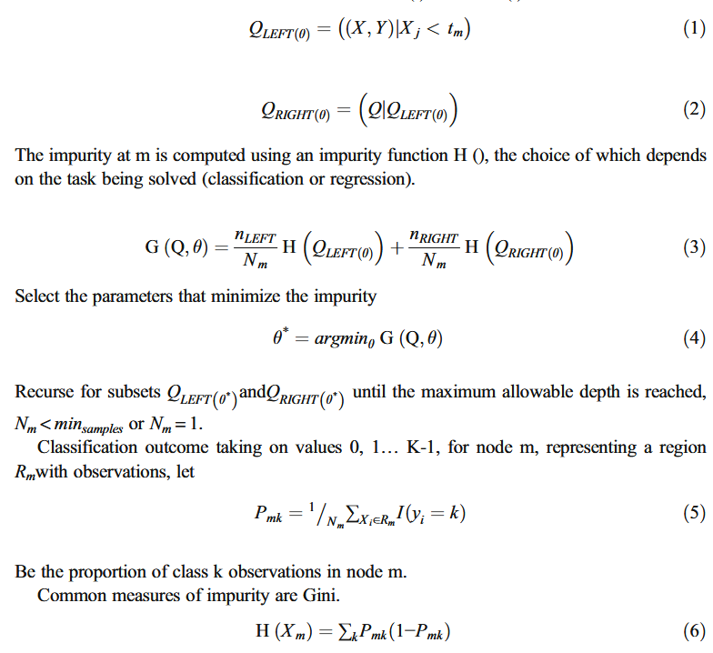
Proposed Solution Contd..
The PART method is employed in this step to build the classifier for prediction purposes; it provides unique rules that can identify the similarity data of each subset of dataset characteristics with the output labels.

Slide 8
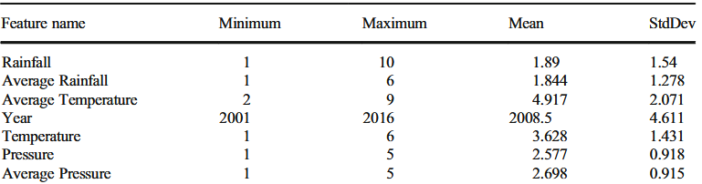
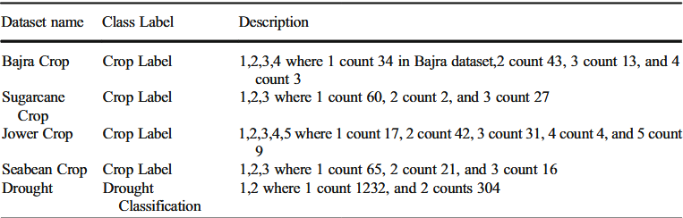
Performance metrics
The performance evaluation of machine learning model in a precise classification and prediction task is measured by several statistical and mathematical models are used. These performance evaluation metrics such as accuracy, precision, recall, and f-score are used to compare the performances of the proposed algorithm compared to existing ones

Slide 9
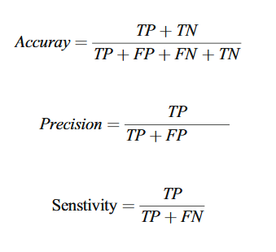
Performance metrics contd..
The remarks are achieved by considering true negatives (TN), true positives (TP), false positives (FP), and false negatives (FN). The accuracy of the classification model on a specified test is the percentage of the test set that is correctly classified by the classifier. Precision is the measure of the correctness of positive labeled examples. The recall is the measure of completeness or accuracy of positive examples that how many examples of the positive class are labeled correctly

Slide 10
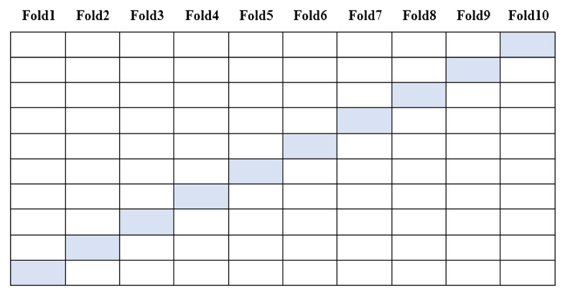
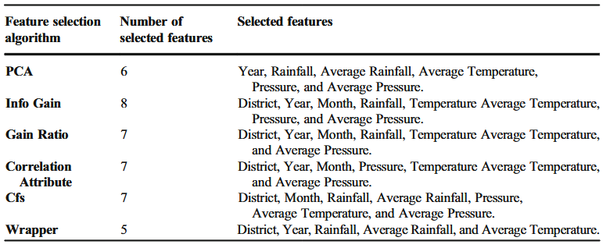
10-fold cross-validation method
Commonly, this method is utilized to evaluate prediction methods. This method has the advantage of reducing the bias that happens in the training and testing datasets using random sampling. First, the dataset is separated into k equal subsets. Then, (k-1) subsets are used to train the model and the kth subset is used for testing the model. This method is recurrent k times using k different training and testing datasets.

Slide 11
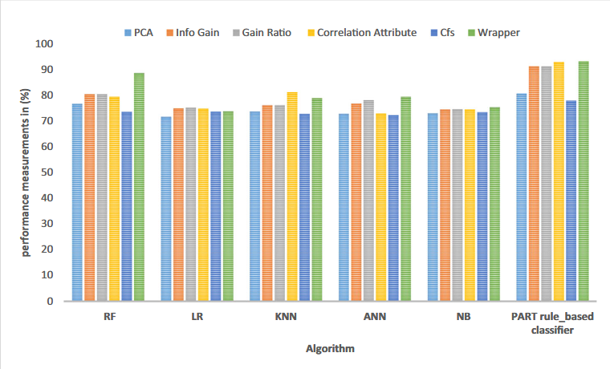
10-fold cross-validation method

Slide 12
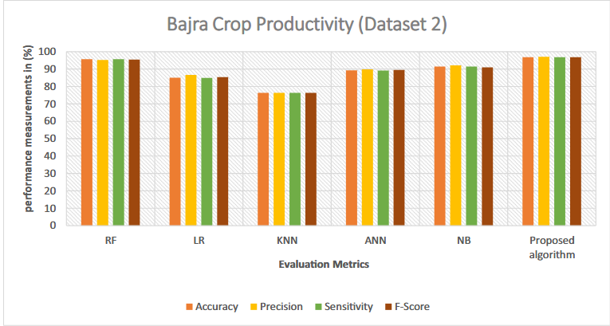
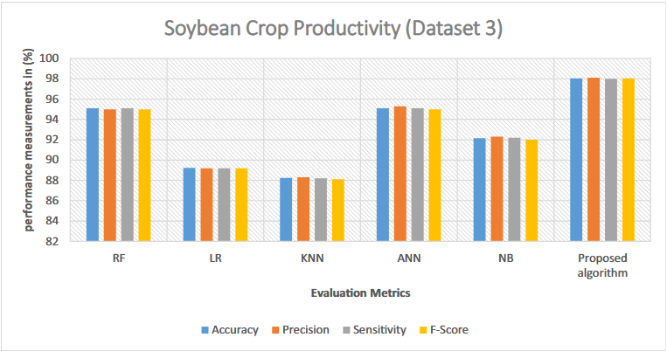
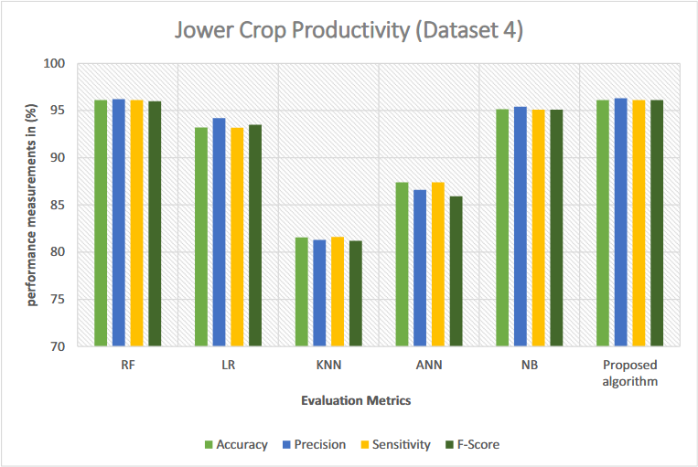
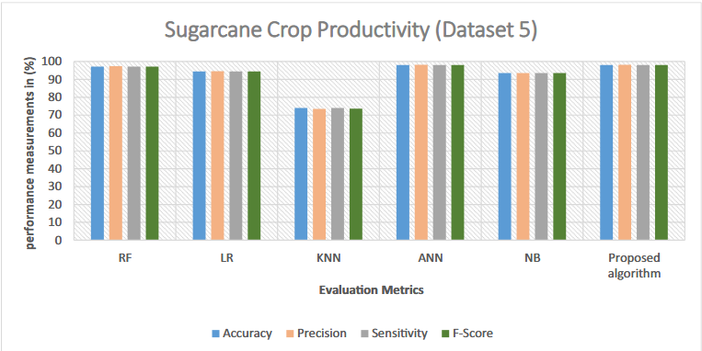
Result Analysis

Slide 13
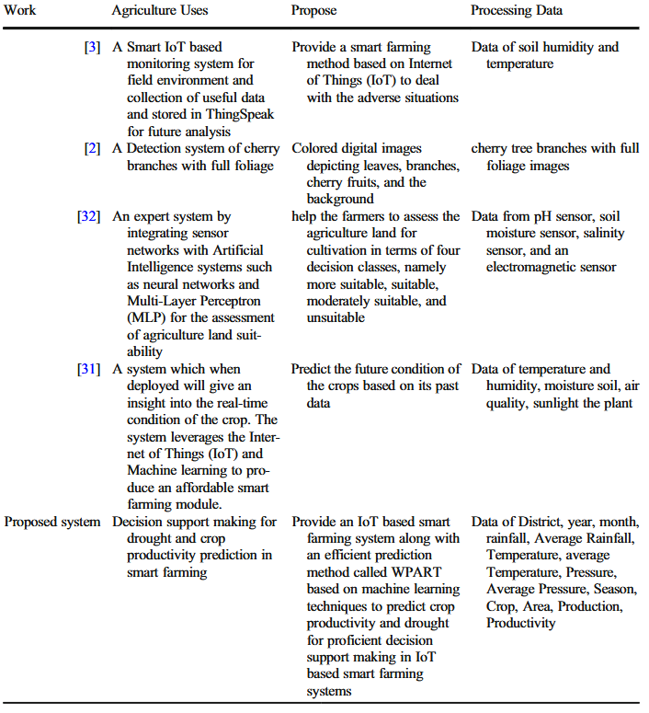
Analysis contd…
In our experiments, single classifiers produced accuracy values of 88.54, 80.27, 79.82, 81.77,80,01 and 92.51 for RF, LR, KNN, ANN, and NB respectively, during the validation/training for Bajra Dataset. While, the combination of PART classifier algorithm with wrapper feature selection produce accuracy values 92.51 for Bajra dataset.

Slide 14
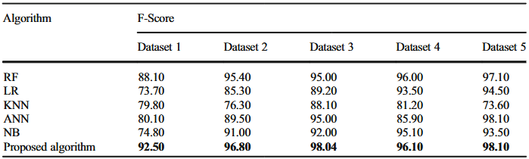
Final Results and Conclusion
an efficient prediction method named WPART is presented that can be employed in the decision-making system in a smart farming environment that depending on IoT based system.
Accuracy is 93.42% and F-Score is 93.40%, which these rates are significant compared with the current methods.
Tip: The proposed method used both of Wrapper feature selection, and PART algorithm

Slide 15
Future Work
For future improvement, we consider using time-series analysis to predict future values based on previously observed values. Also, we can broaden our scope by also adding other parameters such as soil quality, agricultural inputs, soil nutrients, irrigated area. These parameters should account for anomalies in the data, as well as improve the accuracy by multi-fold. Unsupervised clustering to label data for classifiers will also improve accuracy. Also, we planned to use IoT based computer vision system using deep learning models to improve the quality of production in the smart farming field.

Slide 16
References
Paper used to explain – IoT based Smart Farming System using ML

Slide 17
Thank you

